Slide 1

Heaps & Priority Queues
CISC 610
Data Structures & Algorithms
Brian Grey

Slide 2
What are we doing today?
Priority Queues (Briefly)
Self- Balancing Trees
Heaps
Heap-Order Property
Insertion & Upheaping
Deletion & Downheaping
Storage Paradigm
Priority Queues & Heaps

Slide 3
Priority Queues (Briefly)
Think back to queues…
FIFO data structure
What if we want to remove things based on importance instead of insertion order?
Priority Queues
Items are removed by priority (usually lowest being first)
Remember: “Priority 1” means “The highest priority”
Items of equal priority are removed arbitrarily
If two items are tied for the highest priority, then you cannot depend on which item will be returned first

Slide 4
Priority Queues (Briefly)
Priority Queue Interface
add(k, x)
Inserts an item with key k and value x
remove_min() (or, sometimes, just remove())
Removes and returns the next item (typically with smallest key)
min() (or, sometimes, next()
Returns, but does not remove, an item with smallest key
len(P), is_empty()
Returns the number of elements in the PQ or if it’s empty
These methods are less universally implemented

Slide 5
Priority Queues (Briefly)
How will we store things?
Information must be stored in (key, value) pairs
Value: the value of interest to be stored
Key: the priority of the of that value
What will our backing data structure be?
We can use anything we want
A plain list would work…
Of course, would we want that list to be sorted or unsorted?
And what would the performance of that list be?

Slide 6


Priority Queues (Briefly)
Consider the unsorted list:
Inserting into the list is easy
It can just go at the end, O(1)
Finding the next/min element is hard
Each element must be check in a sequential search, O(n)
Consider the sorted list:
Now, the next element is always at the front, O(1)
But inserting means finding the right spot, O(n)
There’s got to be a better way!

Slide 7
Heaps
What is a heap?
A complete, self-balancing binary tree where each node meets the heap-order property
Complete tree?
Every level is completely filled except for (possibly) the last
If the last level is not completely filled, it is filled from left to right
Self-balancing tree?

Slide 8

Self-Balancing Tree
What is a self-balancing tree?
A tree that automatically distributes nodes evenly across a level before moving on and increasing the height
Red-black trees, AA trees, scapegoat trees, and heaps
Okay, so what’s the big deal?
Recall the equation for the height of any binary tree
$h≥(\log_{2}{(n+1))−1}$
If we can minimize the height and guarantee that we can find an element by iterating a path from root to leaf
Run time = $O\left(h\right)=O((\log_{2}{(n+1))−1})$ $=O(\log{n})$

Slide 9
Heaps
What is a heap?
A complete, self-balancing binary tree where each node meets the heap-order property
Complete tree?
Every level is completely filled except for (possibly) the last
If the last level is not completely filled, it is filled from left to right
Self-balancing tree?
Heap-order property?

Slide 10
Heap-Order Property
Heap-order property states that there must be a certain relationship between a parent node and its child nodes throughout the heap
Max heap ordering property
Ordering value of the parent ≥ order value for all its children
Min heap ordering property
Ordering value of the parent ≤ order value for all its children
NOTE: For both ordering properties, the heap may be entirely populated by the same ordering value

Slide 11
Heaps
What is a heap?
A complete, self-balancing binary tree where each node meets the heap-order property
Complete tree?
Every level is completely filled except for (possibly) the last
If the last level is not completely filled, it is filled from left to right
Self-balancing tree?
Heap-order property?

Slide 12
Inserting into a Heap
Two step procedure:
Insert a new node while keeping the tree complete
Restore the heap order via upheap bubbling
Insert a new node while keeping the tree complete
We need to create a new node either:
In the left most empty spot of the lowest level
If the lowest level is complete, as the left child of the left-most leaf

Slide 13
Upheap Bubbling
Restore the heap order via upheap bubbling
Inserting the new node might violate the heap-order property
Upheaping is designed to restore the heap-order property
Algorithm:
Start with the newly-inserted node
While the current node is not the root and the relationship between the current node and its parent violates the heap-order property
Swap the data from the current node and its parent
Move the current node to the current node’s parent

Slide 14
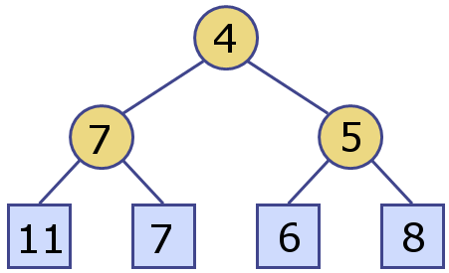
Upheap Bubbling
Example:
Consider the following min heap:
Let’s consider inserting the value of 6 into this heap

Slide 15
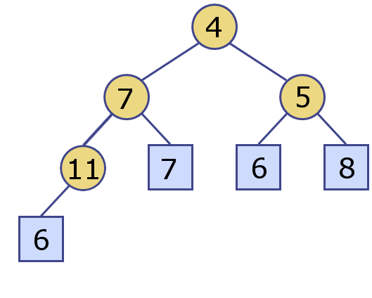
Upheap Bubbling
Example:
Consider the following min heap:
Let’s consider inserting the value of 6 into this heap

Slide 16
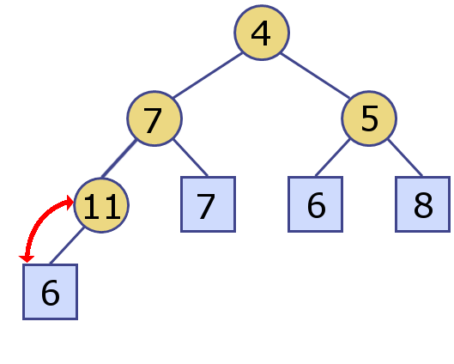
Upheap Bubbling
Example:
Consider the following min heap:
Let’s consider inserting the value of 6 into this heap

Slide 17

Upheap Bubbling
Example:
Consider the following min heap:
Let’s consider inserting the value of 6 into this heap

Slide 18
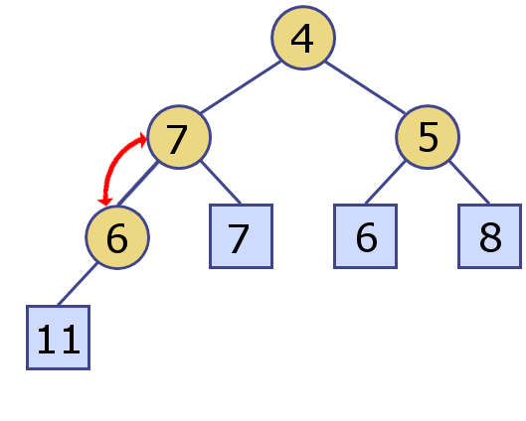
Upheap Bubbling
Example:
Consider the following min heap:
Let’s consider inserting the value of 6 into this heap

Slide 19

Upheap Bubbling
Example:
Consider the following min heap:
Let’s consider inserting the value of 6 into this heap

Slide 20
Upheap Bubbling
Example:
Consider the following min heap:
Do this again on your own, this time with 1

Slide 21
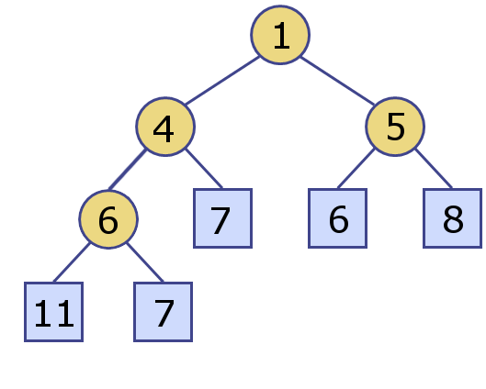
Upheap Bubbling
Example:
Consider the following min heap:
Do this again on your own, this time with 1

Slide 22
Deleting From a Heap
Slightly more complicated (a three step procedure):
Swap the data between the root and the most recently added leaf node
Remove the most recently added leaf node from the heap
Restore the heap order via downheap bubbling
Swapping the key-value pairs is easy
Remove the most recently added leaf node from the heap
Retain the data in the leaf node
Set the leaf node’s parent to None
Set appropriate child of the parent to None

Slide 23
Downheap Bubbling
Restore the heap order via upheap bubbling
Similar to but more complicated than upheap bubbling
Upheap bubbling only has to worry about the parent’s key
Downheap has to account for both children’s keys

Slide 24
Downheap Bubbling
Algorithm:
Start with the root
While the current node is not a leaf and the relationship between the current node and either of its children violates the heap-order property
Swap the data from the current node and its child which fulfills the heap-order property the most
(i.e. The min key in a min heap, the max in a max)
Move the current node to the child node that it just swapped with

Slide 25
Downheap Bubbling
Example:
Once again, consider the following min heap:
What happens when we remove an element?

Slide 26

Downheap Bubbling
Example:
Once again, consider the following min heap:
What happens when we remove an element?

Slide 27
Downheap Bubbling
Example:
Once again, consider the following min heap:
What happens when we remove an element (AGAIN)?

Slide 28
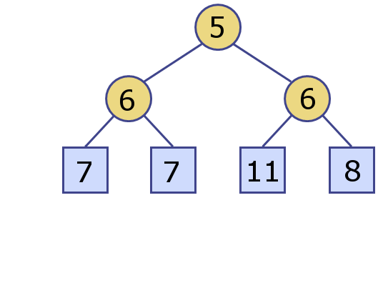
Downheap Bubbling
Example:
Once again, consider the following min heap:
What happens when we remove an element (AGAIN)?

Slide 29
Heap Performance
Heaps perform very well under all circumstances
Because adding or removing will, at most, traverse the height of the tree, both functions run in O(log n) time
Accessing the next value to be removed is O(1) as this value is stored at the root
Asymptotic analysis depends on accessing nodes in O(1)
Two values with the ordering value must be considered to be returned in an arbitrary order
Oh, and a heap can be constructed from an existing list of data in O(n) time

Slide 30
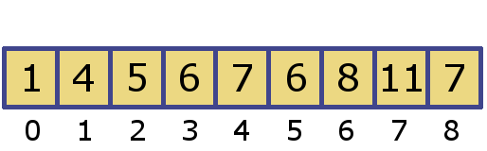
Array-Based Heap Implementations
Wait…I thought a heap is a binary tree?
We will simulate the tree structure using an array and some clever math
Consider the heap:
The root (1) goes at index 0
Left child of the root (4) at index 1
Right child of the root (5) at index 2
Continue this pattern across all levels moving down levels as you complete the previous

Slide 31

Array-Based Heap Implementations
Do we see a pattern?
Children of the root at index 0 are at indices 1 and 2
Children of the right child of the root (index 2) are at indices 5 and 6
If the index of the current node is $i$:
The left child is at $2i+1$
The right child is at $2i+2$
The parent is $\left(i−1\right)//2$

Slide 32

Array-Based Heap Implementations
Benefits?
Math is fast (calculations are O(1))
Structure is static
If we have a heap size of $n$:
Adding a new node is as simple as writing to index $n$
The heap pictured has $n$ = 9
Removing an element requires:
Swap index 0 and $n−1$
Remove index $n−1$

Slide 33
Bottom Up Heap Construction
Constructing a heap from a previously established list of data
Algorithm:
Start with data arbitrarily sorted in an array
Starting with last internal node in the array and stopping at the root
Reheap/downheap on itself and its children
Move to the previous internal node in the array

Slide 34
Bottom Up Heap Construction
Okay, so what’s the big deal?
The heap can be constructed in place without needing to recreate a new array/data structure
Far more efficient to create this way
All leaves are assumed to be in order so we skip half of the nodes
At the first level above the leaves, we process half of the remaining nodes but only do a maximum of 1 swap
At the second level above the leaves, we process half of the nodes that are unprocessed but only do a maximum of 2 swap
…

Slide 35

Bottom Up Heap Construction
Okay, so what’s the big deal?
The heap can be constructed in place without needing to recreate a new array/data structure
Far more efficient to create this way
Creation of heap can be accomplished in O(n) time
Compare this performance with top-down construction
$n$ elements to be inserted with a run time of O(log n)
Therefore, run time is O(n log n)

Slide 36

Using a Heap to Sort
Yeah, it’s called HeapSort (Catchy, right?)
Getting the information into the heap can be done in either O(n) or O(n log n) time
Depends on top-down or bottom-up construction
We need to iteratively remove $n$ elements
Each removal runs in O(log n)
Therefore, run time is O(n log n), regardless of heap construction
Runs slower than Quicksort in the average case, faster in the worst

Slide 37
Heaps & Priority Queues
Okay, but what does this have to do priority queues?
Using an array-based heap implementation as the backing data structure is one of the fastest ways to implement a priority queue
Each slot in the array will store a key-value pair
Heaping will be done using the key, while the value is the relevant data
From an implementation perspective, the key does all the work, but the value is coming along for the ride
From a user perspective, the key is only there to make the machine work, but the value is what is most important to store and retrieve

Slide 38
Questions?

